Slide 1
HealthVis: making personal health visualizations accessible for blind and low-vision people
Team members: Emily Aymond Madeline Davis Jaimie Morris
Faculty Advisors: Dr. Faust
Dr. Hassan

Slide 2
Overview of the Problem
Tracking personal health data is increasingly popular
1 in 5 Americans use a fitness tracker or mobile device for tracking purposes
Technologies rely on graphical interfaces and are vision-dependent
Six million Americans have low vision and one million are blind, making this virtual data inaccessible
BLV people report that current technology is suboptimal and tedious
Notes:
Emily

Slide 3
Goals & Challenges
Goals:
Visualization of multiple different health measures such as heart rate, step count, etc.
Accessible features using keyboard/click-based navigation, sonification, and user-friendly fonts and font sizes
AI summarization to help users understand their health data
Challenges:
Public availability of health data for testing
Implementing accessibility features
AI integration
Feeding the model the visualization vs the data itself
Notes:
Emily

Slide 4
Proposed Approach
Our project aims to create an app/website that allows BLV people to independently access and record personal health data.
Accessibility Features:
Keyboard/ clicked based navigation
Sonification
AI-generated summaries
User can select font, font size, and color
Notes:
Madeline

Slide 5
Previous Relevant Work
CharA11y
Tactile-first plots
Useful as a model for accessibility visualization
MAIDR
Statistical plots for BLV people
Useful for modeling implementation in the user interface
Lots of research on the importance and need for accessibility in personal health data
Notes:
Madeline

Slide 6
Main Tasks: User Interface
Built accessibility-centered foundation of the app (iOS + Web) using React Native (Expo).
Implemented multimodal accessibility: Audio, Haptics, Text-to-Speech, Screen Reader Announcements; Four modes (Visual, Audio, Hybrid, Simplified)
Added core accessibility properties:
Accessibility labels & hints on all elements
Large touch targets (44–56pt)
High-contrast mode (WCAG AAA)
State-aware announcements & progressive disclosure
Built health data flow: file upload (CSV, JSON, Apple Health ZIP) → parsing → storage → display.
Implemented interactive accessible charts with touch-to-explore + audio + haptic feedback.
Notes:
Jaimie

Slide 7
User Interface Challenges
Making charts and data exploration fully accessible (50ms feedback, no overlap)
Parsing large Apple Health ZIP files on mobile devices
Handling cross-platform differences between iOS and Web (files, audio, haptics)
Building reliable error handling (retries, timeouts, offline support, recovery UI)
Notes:
Jaimie

Slide 8
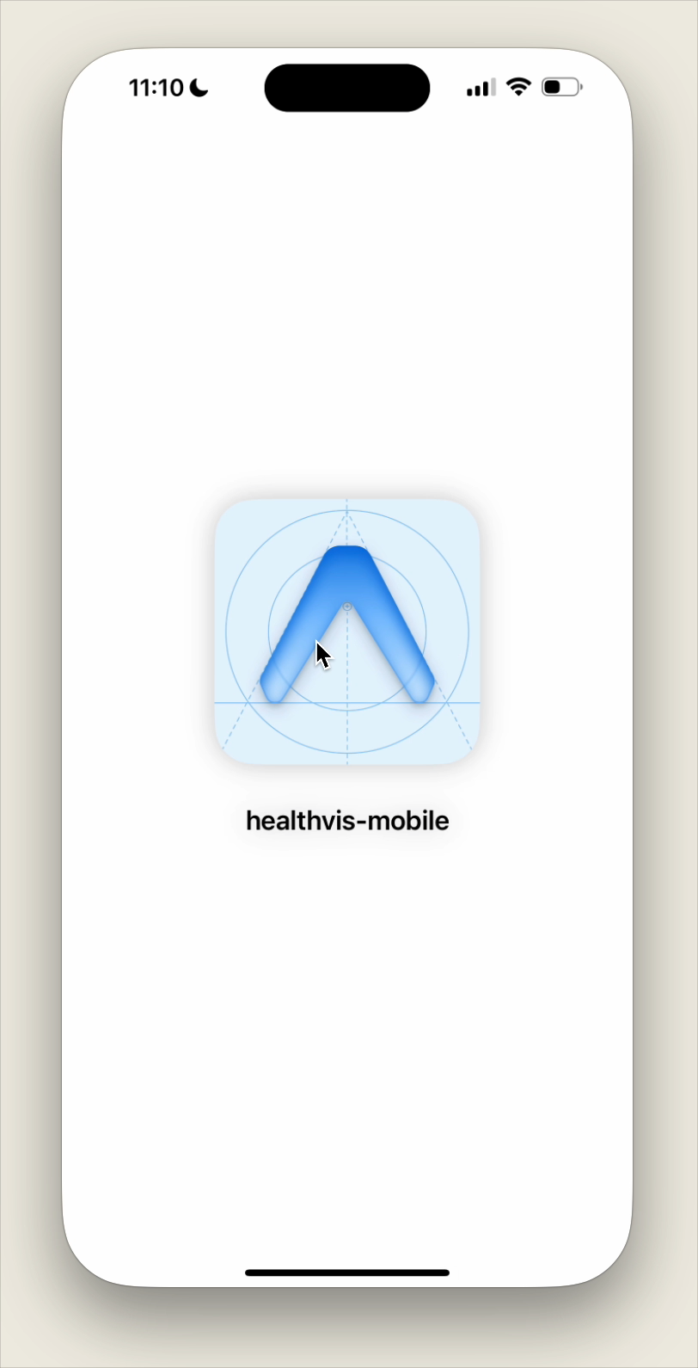
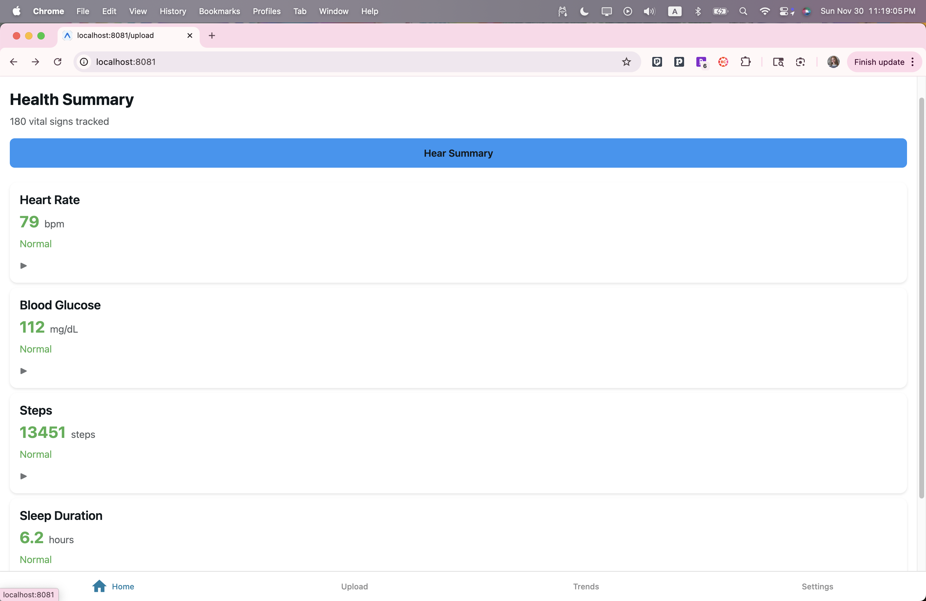
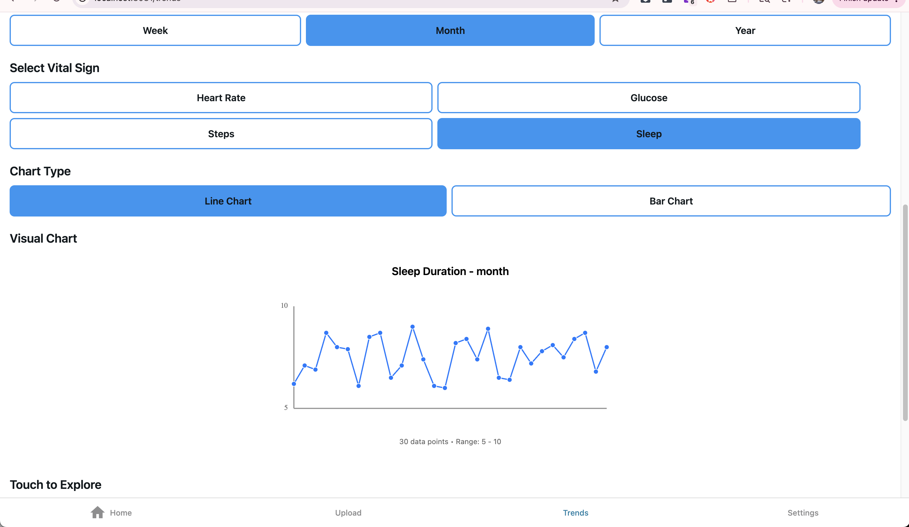
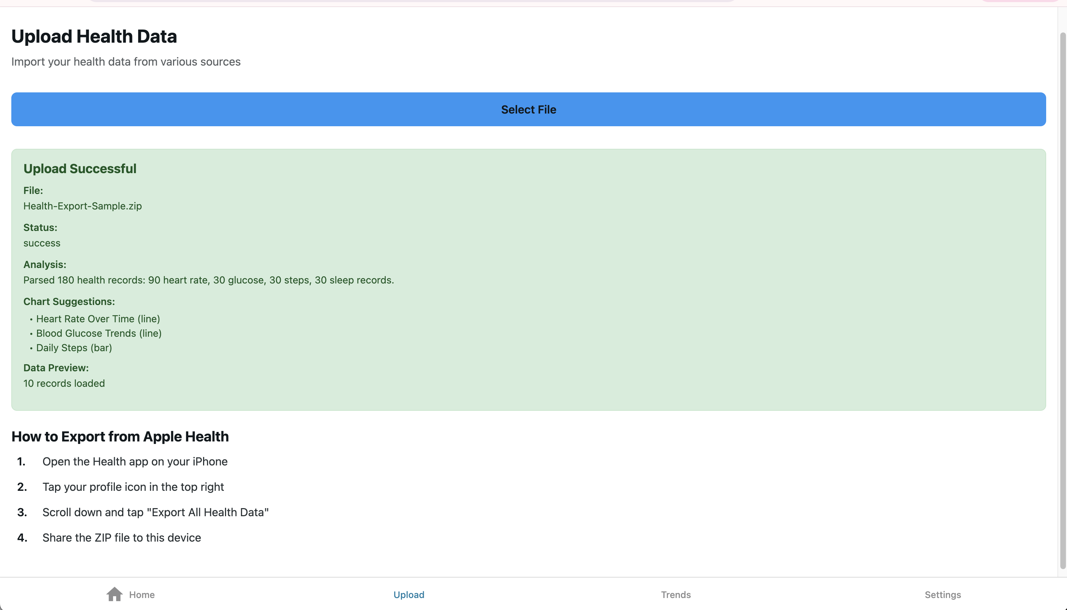
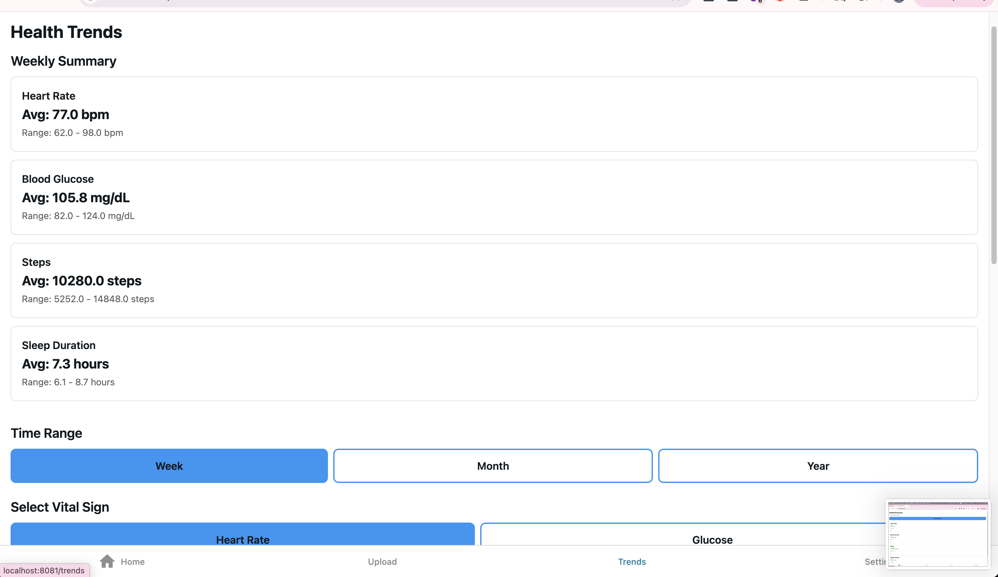
Notes:
Jaimie

Slide 9
Main Tasks: Data Visualization
Team Members: Emily & Madeline
Steps taken:
D3 visualization using team members’ health data
Wrapped D3 into the HTML for the UI for successful integration
Challenges:
D3 Learning Curve
Extracting Apple Health Data
Results:
Successful integration of D3 visualizations with UI
Notes:
Emily

Slide 10
Extracting Apple Health Data
Apple Health data is exported as a very large XML file
Used ElementTree to load and parse through the data and save it as a CSV
Initially focusing on heart rate data
Used d3 to create graphs for both Resting Heart Rate and Daily Heart Rate Changes
Notes:
Madeline

Slide 11
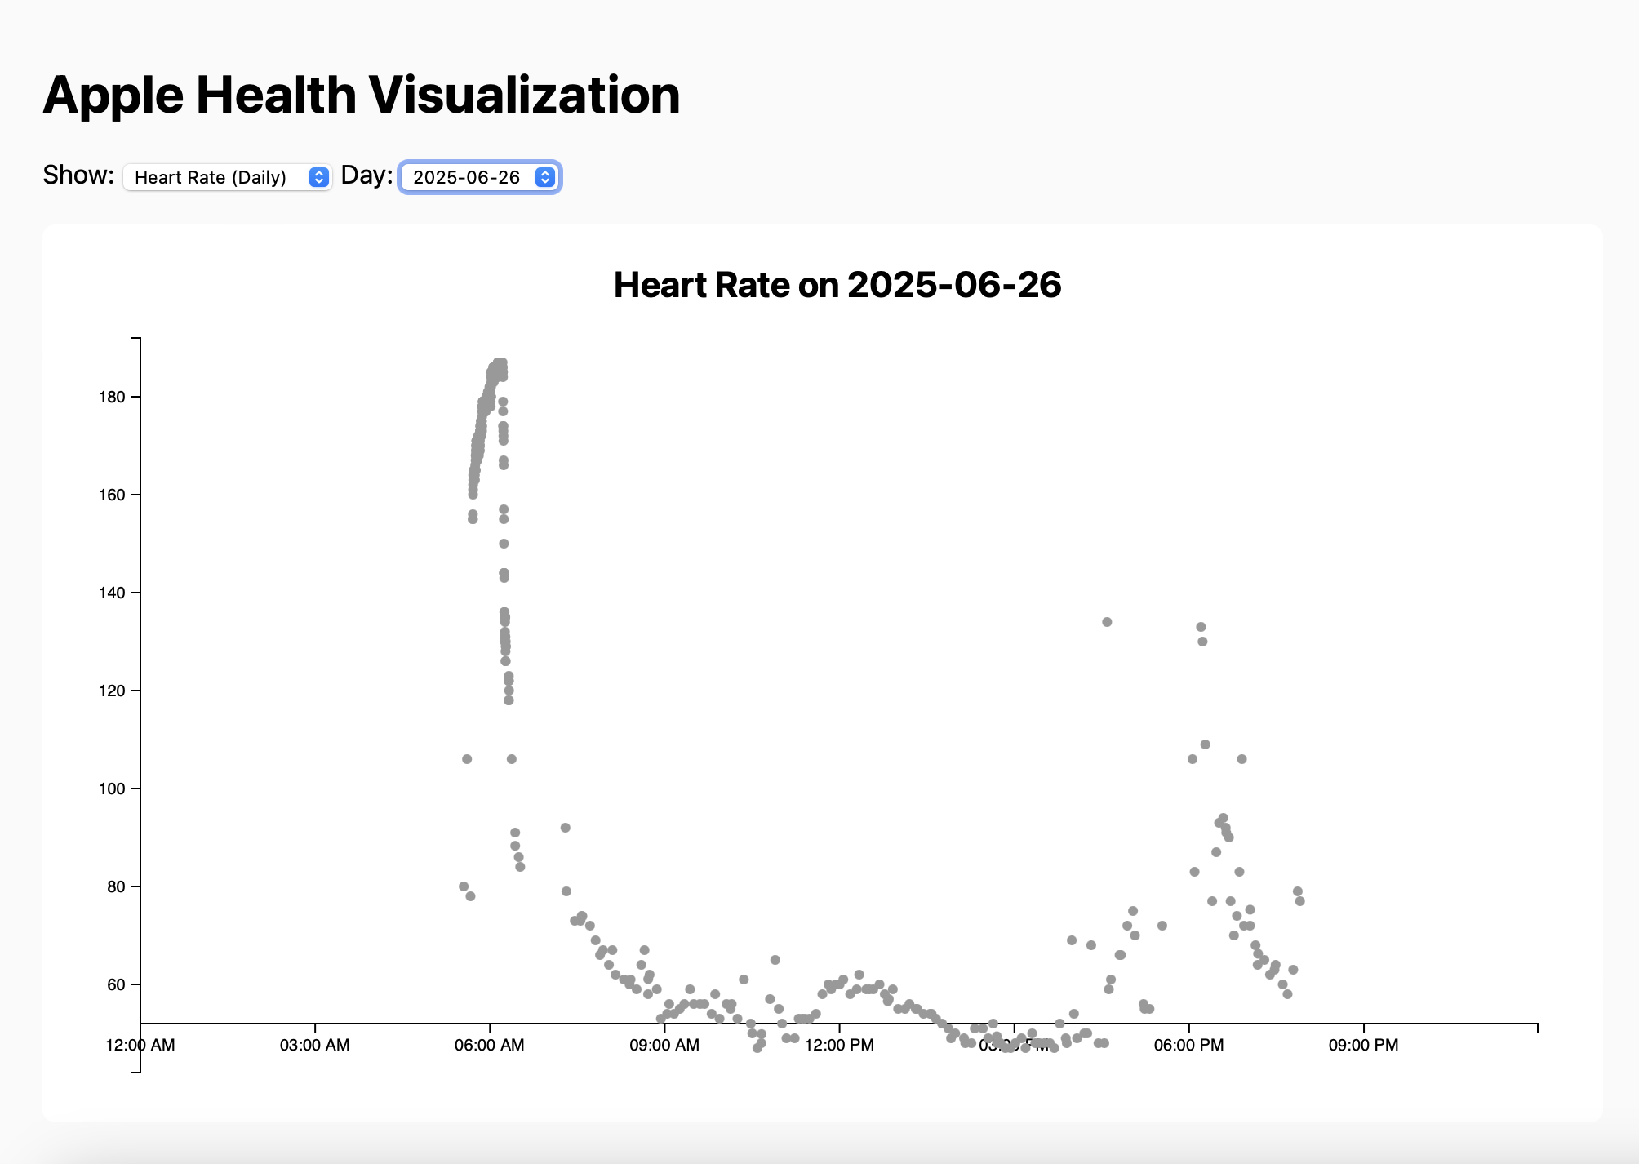
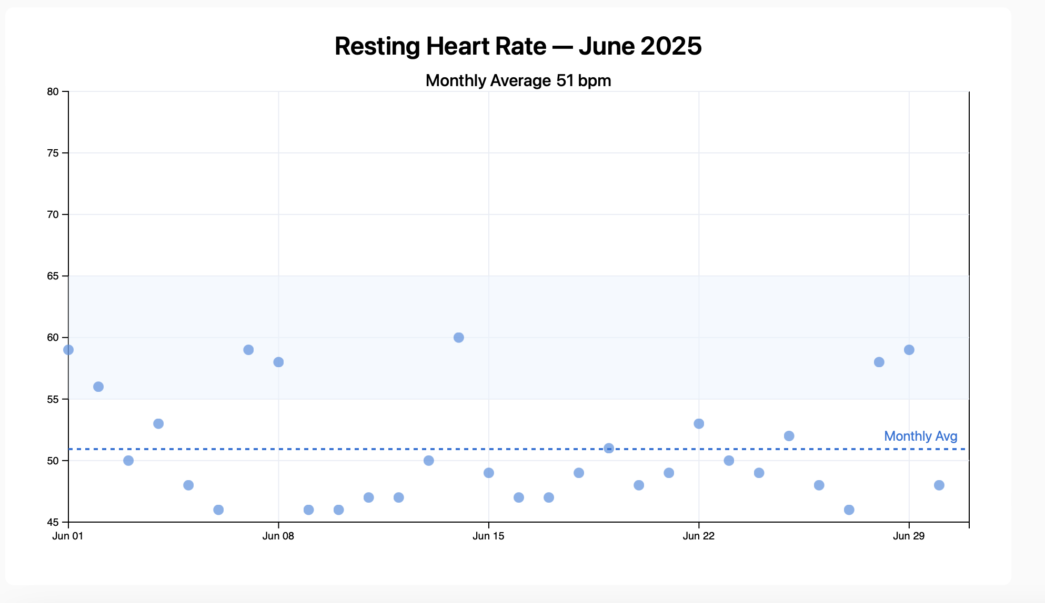
UI Data Visualization
Notes:
Emily

Slide 12
Goal for Visualizations
Right now, we are creating a separate script for each health metric. Our goal is to build a single, flexible script that can read any CSV file and automatically generate the appropriate visualization. This would allow the user to select the type of graph they want to see and the specific time range they want to explore.
This approach will not only make our data more accessible and interactive, but it will also support future work as we expand to a broader range of health metrics.
Notes:
Emily

Slide 13
Main Tasks: AI Integration
Steps Taken:
Created an AI bot
Connected the bot to the backend of our UI
Enabled it to summarize selected heart-rate data
Challenges:
Data is very large for LLM token
Ensuring correct info & preventing AI hallucination
Getting consistent, structured output
Results:
The bot successfully analyzed and summarized resting-heart-rate trends
Notes:
Madeline

Slide 14
Remaining Work
Full AI integration
Implementing structured AI output summaries for the data and trends
UI:
Adding the AI information to the frontend
Testing with device default accessibility features and adding enhancements
Adding keyboard functionality to Web view
Enhancing the datasets
Making the UI equally good as the current options, just more accessible
Notes:
Jaimie

Slide 15
Timeline for Next Semester
Phase I:
AI Integration
Phase II:
Implement accessibility features
Phase III:
Refining for SSE Expo
Notes:
Emily

